Slide 1
Random population-based decomposition
method by Linkage identification with
non-linearity minimization on graph
Zhong Rui
Graduate School of Information Science and Technology
Hokkaido University
Munetomo Masaharu
Information Initiative Center
Hokkaido University

Slide 2
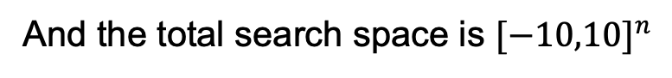
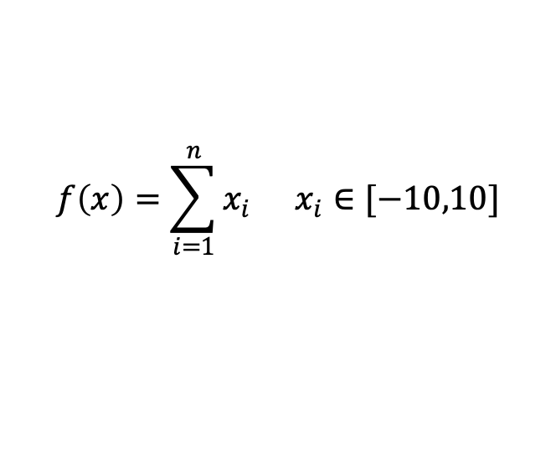
Introduction
Background:
The large-scale optimization problem is difficult to solve:
The complexity increases
The search space increases exponentially (the curse of dimensionality)
Building a surrogate model is expensive
A simple example of the curse of dimensionality:
$$f\left(x\right)=\sum_{i=1}^{n}{x_{i}} x_{i}∈[−10,10]$$
And the total search space is ${[−10,10]}^{n}$

Slide 3
Related techniques
Cooperative Co-evolution (CC):
This strategy decomposes the problem into multiple sub-problems and optimizes the sub-problems alternately.
Problem
CC is sensitive to the decomposition
A perfect decomposition can exponentially reduce the search space without losing accuracy in optimization
decompose
sub-problem 1
sub-problem 2
…
sub-problem n
optimize independently
solution 1
solution 2
…
solution n
CC is a mainstream framework to solve the large-scale optimization problem
merge
Fig. 1: The flowchart of the CC framework

Slide 4
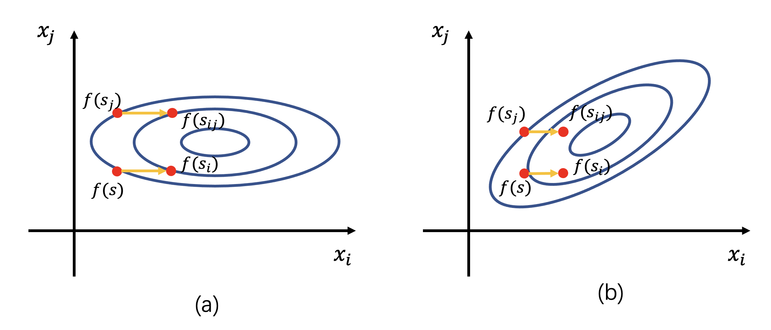
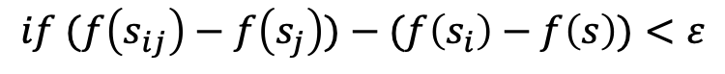
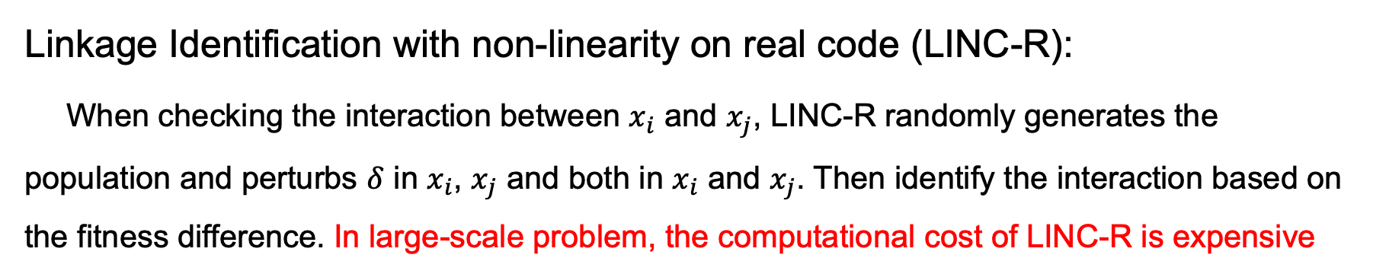
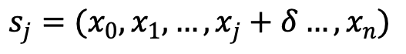
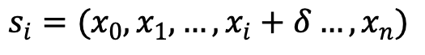
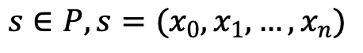

Related techniques
Linkage Identification with non-linearity on real code (LINC-R):
When checking the interaction between $x_{i}$ and $x_{j}$, LINC-R randomly generates the population and perturbs $δ$ in $x_{i}$, $x_{j}$ and both in $x_{i}$ and $x_{j}$. Then identify the interaction based on the fitness difference. In large-scale problem, the computational cost of LINC-R is expensive
$$s∈P, s=(x_{0},x_{1},…,x_{n})$$
$$s_{i}=(x_{0},x_{1},…,x_{i}+δ…,x_{n})$$
$$s_{j}=(x_{0},x_{1},…,x_{j}+δ…,x_{n})$$
$$s_{ij}=(x_{0},x_{1},…,x_{i}+δ,…,x_{j}+δ…,x_{n})$$
$$if (f\left(s_{ij}\right)−f\left(s_{j}\right))−(f\left(s_{i}\right)−f\left(s\right))<ε$$
Fig. 2: (a). LINC-R works on separable function
(b). LINC-R works on non-separable function
$$Then x_{i} and{ x}_{j} are separable$$

Slide 5
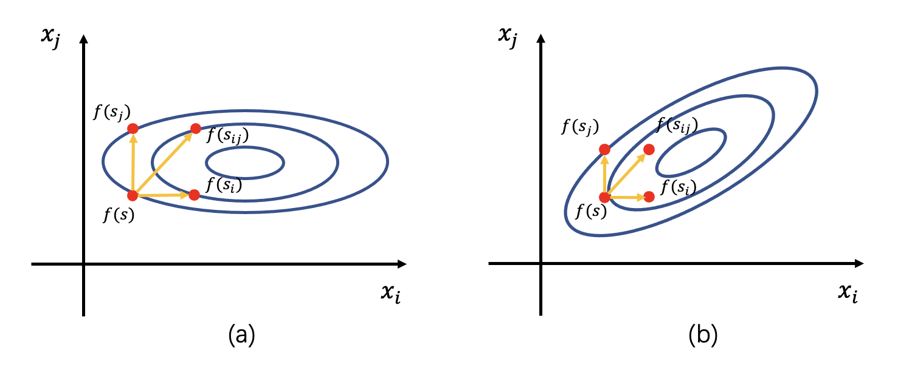


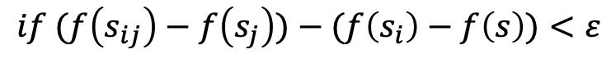
Our Proposal: graphLINC-Rmin
A variant LINC-R :
We notice that LINC-R can be transformed into the vector additive form.
$$if (f\left(s_{ij}\right)−f\left(s_{j}\right))−(f\left(s_{i}\right)−f\left(s\right))<ε$$
$$Then x_{i} and{ x}_{j} are separable$$
$$if (f\left(s_{ij}\right)−f\left(s\right))−\left(f\left(s_{i}\right)−f\left(s\right)+f\left(s_{j}\right)−f\left(s\right)\right)<ε$$
$$Then x_{i} and{ x}_{j} are separable$$
Fig. 3: (a). A variant LINC-R works on separable function
(b). A variant LINC-R works on non-separable function

Slide 6
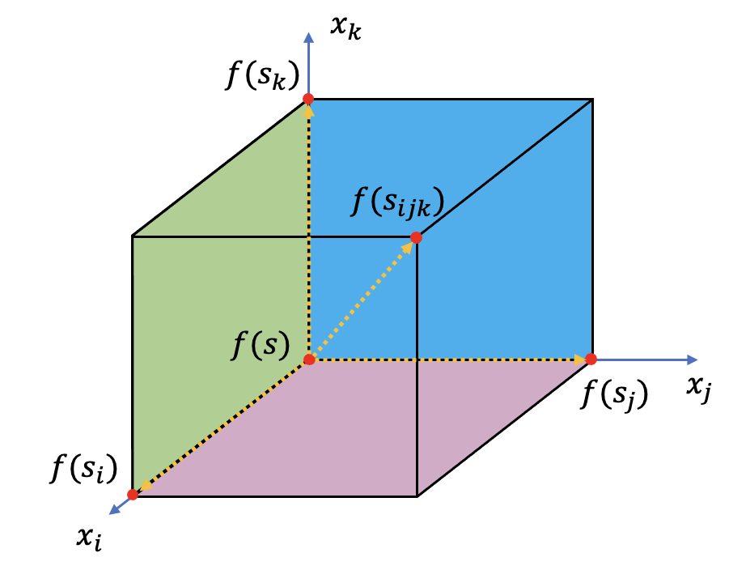
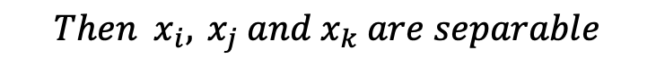
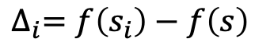
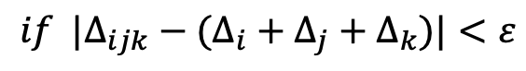
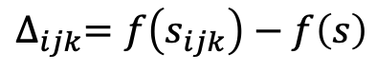
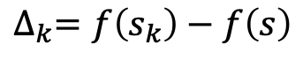
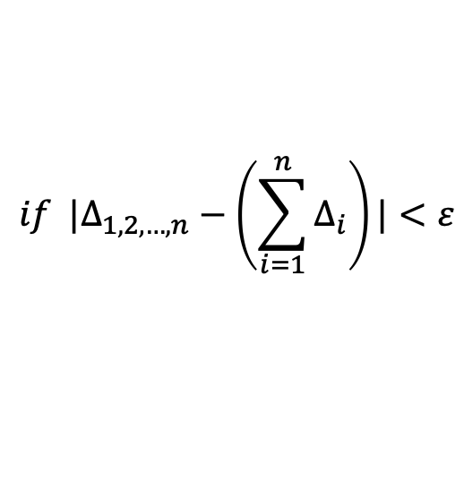
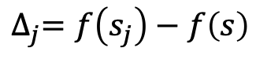
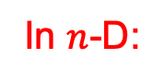
Our Proposal: graphLINC-Rmin
A variant LINC-R in 3-D space:
And we derive this variant LINC-R to 3-D space
$$∆_{i}=f\left(s_{i}\right)−f\left(s\right)$$
$$∆_{j}=f\left(s_{j}\right)−f\left(s\right)$$
$$∆_{k}=f\left(s_{k}\right)−f\left(s\right)$$
$$∆_{ijk}=f\left(s_{ijk}\right)−f\left(s\right)$$
$$if {|∆}_{ijk}−(∆_{i}+∆_{j}+∆_{k})|<ε$$
$$Then x_{i},{ x}_{j} and{ x}_{k} are separable$$
In $n$-D:
Fig. 4: A variant LINC-R works 3-D space
$$if |∆_{1,2,…,n}−\left(\sum_{i=1}^{n}{∆_{i}}\right)|<ε$$
$$Then this function is fully separable$$

Slide 7
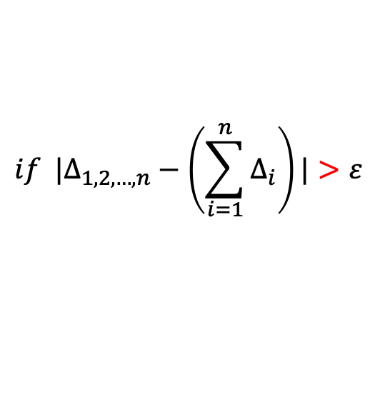
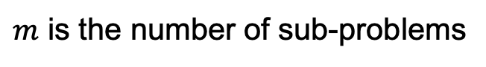
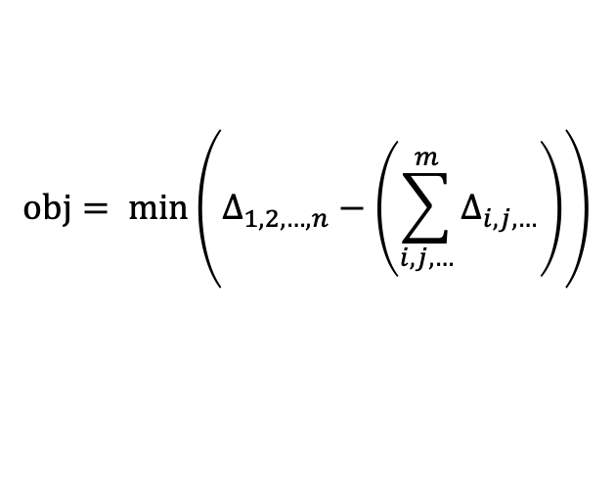
Our Proposal: graphLINC-Rmin
A remaining problem:
$$if {|∆}_{1,2,…,n}−\left(\sum_{i=1}^{n}{∆_{i}}\right)|>ε$$
The decomposition problem becomes the combinatorial optimization problem, and the object function is
We only know the interactions exist in some variable pairs, but we do not know in which pairs
$$obj= min\left(∆_{1,2,…,n}−\left(\sum_{i,j,…}^{m}{∆_{i,j,…}}\right)\right)$$
Take an example in 3-D:
$$if {|∆}_{ijk}−\left(∆_{i}+∆_{j}+∆_{k}\right)|>ε and {|∆}_{ijk}−\left(∆_{ij}+∆_{k}\right)|<ε$$
$$Then x_{i},{ x}_{j} are non−separable,and{ x}_{k} is separable to{ x}_{i} and{ x}_{j}$$
$m$ is the number of sub-problems
We can apply the heuristic algorithm to find interactions actively!

Slide 8
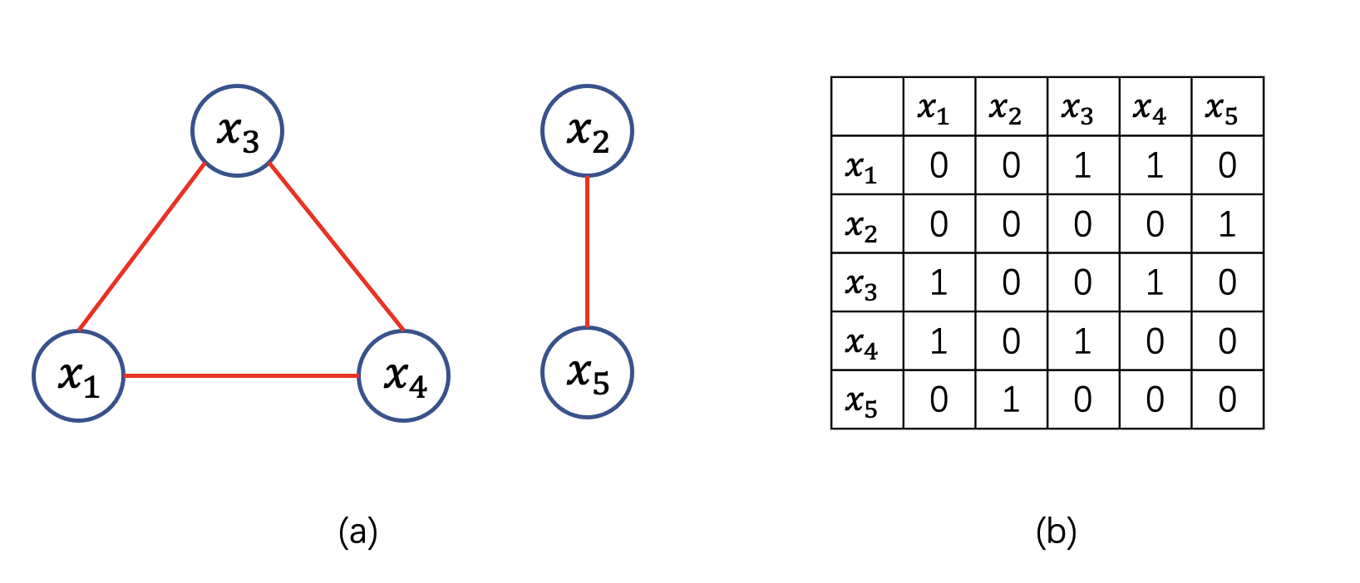
Our Proposal: graphLINC-Rmin
The optimizer design
We notice that the interaction between variables can be represented by adjacent matrix
Take a simple example with 5 variables
Fig. 5: (a). A problem with 5 variables, the red line represents the interaction.
(b). The adjacent matrix transformed from (a)

Slide 9
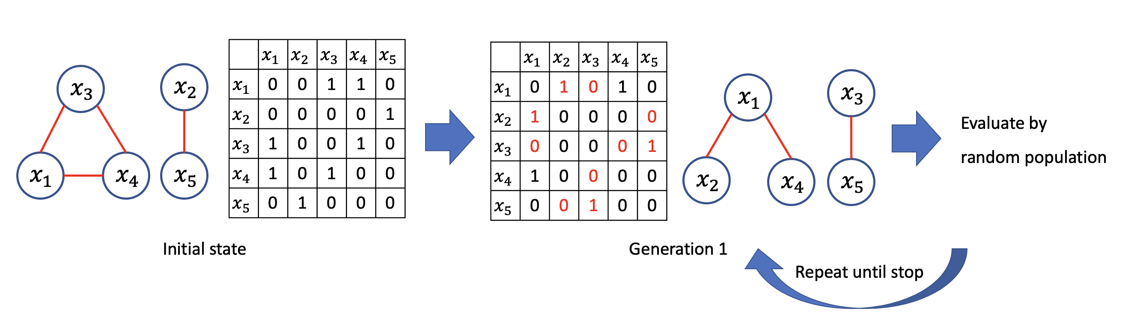
Our Proposal: graphLINC-Rmin
An adaptive randomized local search
We randomly change the connection states and evaluate by object function
Fig. 6: The procedure of the adaptive randomized local search
In the early period of optimization, we modify many connection states to find an acceptable solution. And in the late period, we modify little connection states to approach convergence.

Slide 10
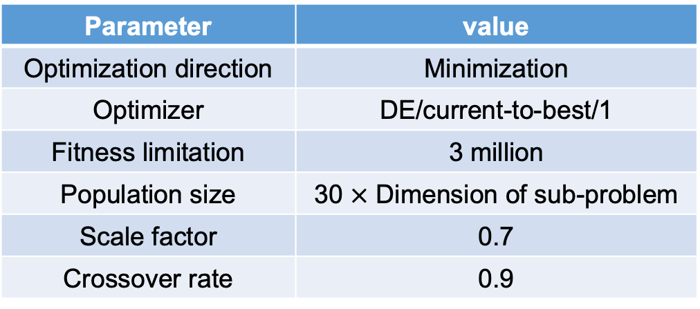
Experiment
Experiment conditions
We test our proposal on CEC2013 LSGO Suite for 25 trial runs and comparing with DECC-DG
Table 1: The parameters of sub-problems optimization
Parameter | value
Optimization direction | Minimization
Optimizer | DE/current-to-best/1
Fitness limitation | 3 million
Population size | 30 $×$ Dimension of sub-problem
Scale factor | 0.7
Crossover rate | 0.9

Slide 11
Experiment
Experiment result
Fig. 7: The convergence curve of our proposal and standard DG, the gap in the initial period is FEs for decomposition

Slide 12
Analysis and conclusion
Analysis:
Our proposal is significantly better than DECC-DG in most functions.
(1). In separable functions, our proposal can correctly decompose the problems and save lots of FEs in the decomposition stage.
(2). In partially separable functions / fully non-separable functions, our proposal can detect the strong interactions and restore them while some weak interactions are ignored.
Conclusion:
In this paper, we proposed a novel decomposition method. And we have some remaining problems to solve in the future.
(1). The object function is multimodal.
(2). The performance of adaptive local search (GAs/EAs)

